Slide 1


April 8, 2024 Solar Eclipse
Delaware County

Slide 2
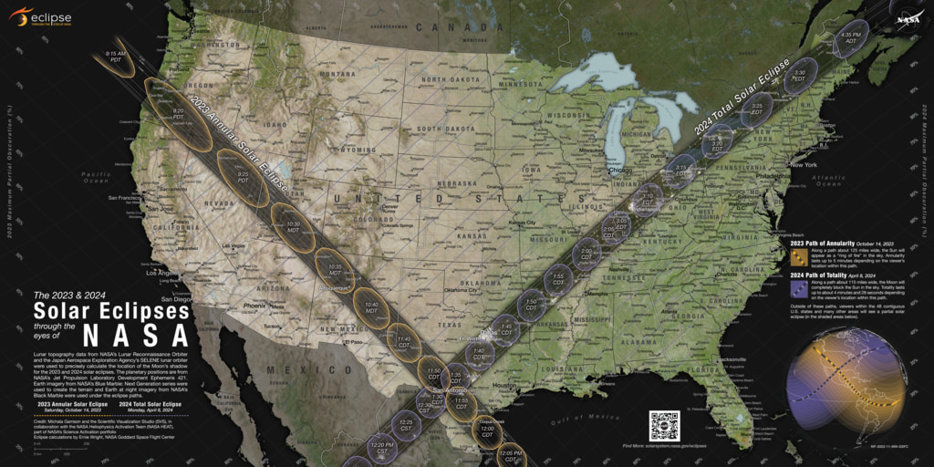
Notes:
This is the map from NASA which show the path of totality for the whole US and beyond.
https://science.nasa.gov/resource/nasas-2023-and-2024-solar-eclipse-map/
Even areas outside of the totality area will have visitors and people traveling through from the eclipse. These areas can also feel the strain on resources due to this event.

Slide 3
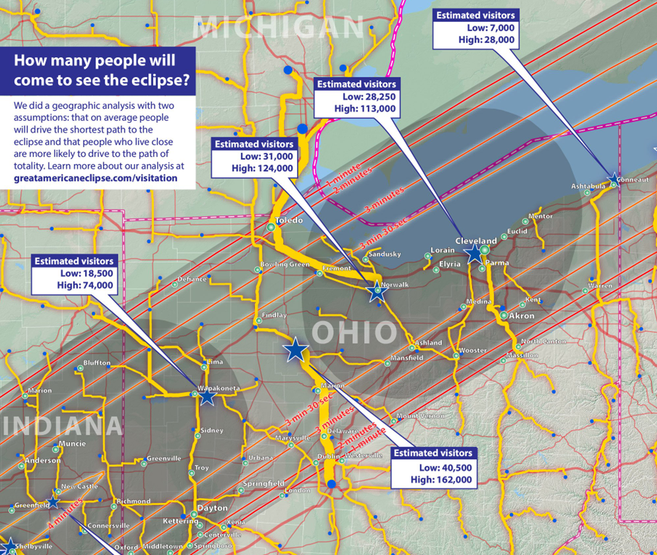
Notes:
https://www.greatamericaneclipse.com/visitation
The estimates for visitation given on this page are derived from these assumptions:
Consider someone who live 200 miles from the centerline of eclipse. This person will certainly have heard about the eclipse from print, broadcast, and social media. This person will have received the impression that the eclipse is a special sight and worth seeing.
Not every one has the freedom travel. Monday is a work day and for some, a school day. Some people may be deterred by stories of past traffic jams at the 2017 eclipse. Some people will simply be completely disinterested.
Weighing these factors, we began with the assumption that for an average person 200 miles away, there is a high possibility of 2% that they would drive to the path of totality and a low possibility of 0.5%. And then halve that estimate for 400 miles, again at 800 miles, and so on.
These are the steps for the geographic analysis we performed:
We began with the US Census county enumeration data from the 2020 census. To constrain a compute-intensive process, we “lumped” the US population into over 3,000 county seats.
We digitized a series of eclipse destination points in the path of totality. We placed these points along highway intersections or off-ramps near the centerline of totality. Don’t thing of these points as exact gathering places but rather represent the local area.
In ArcGIS software, we performed geographic analysis to calculate the shortest drive paths from each county seat to the eclipse destination points. We also know how many people live in that county and the distance of the path of totality.
We apply our assumption as a formula and compute the visitation probabilities from each county seat.
Multiple shortest drive paths will typically converge on a destination. Some up the visitation numbers from each drive path for the destination.
After consideration, we decided to apply additional weights to the visitation estimates, recognizing that a location such as Texas is more likely to experience sunny weather, hence higher visitation.

Slide 4
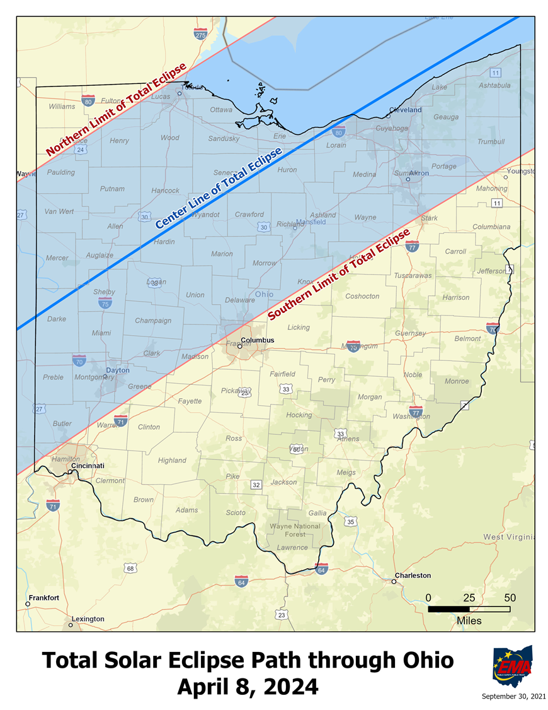
Notes:
On the maps, the outer lines show the extent of the width of the totality pathway, and the inner center line shows the totality center line, where totality will be longest.
You can see on the map that Cincinnati and Columbus are on the southern edge of the totality pathway, and that the totality center line exits out into Lake Erie just west of Cleveland.
Dayton, Akron, Lima, Toledo, Springfield, Sandusky, and other large cities in Ohio are within the totality pathway. Also the City of Delaware
The red line is the edge of the eclipse totality line.
Most of Delaware County will experience some sort of totality
Even areas outside the county can be affected by travelers and the resource stress they bring. Fuel, grocery, and other amenities can be stressed by the amount of population moving through some of the smaller communities and some of the large ones.
Eclipse is Apr. 8, 2024: Here in Delaware County the eclipse will begin about 2:00 pm, with totality starting at about 3:10 pm and lasting under 2 mins. Totality length varies based on where you are in county
Event venues advertised by state: 64-both viewing locations and historic markers
EMA estimated Event venues: 171

Slide 5
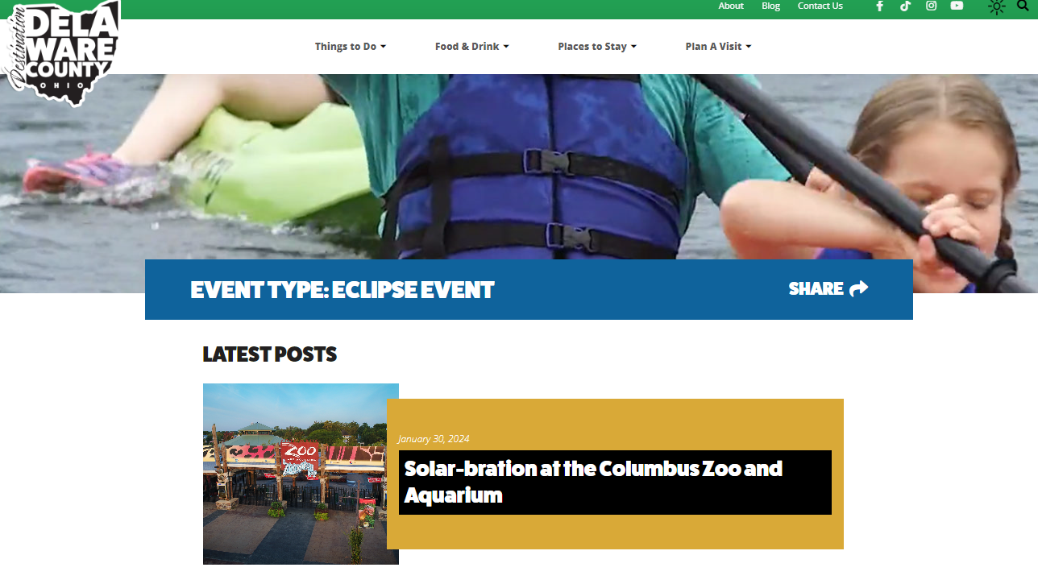

Delaware County Events
If you have an event please let DCOHSEM know. It is important for our operational emergency responders.
National Eclipse Website
2024 eclipse events listed for most affected states
Ohio is listed
  Delaware County is part of the site
Destination Delaware County
Has a listing of events here in Delaware County
Each event has information about registering for the event
https://www.visitdelohio.com/event_listing_type/eclipse-event/
https://nationaleclipse.com/events.html
Notes:
https://nationaleclipse.com/events.html
https://www.visitdelohio.com/event_listing_type/eclipse-event/
If you have an event please let DCOHSEM know. It is important for our operational emergency responders .

Slide 6
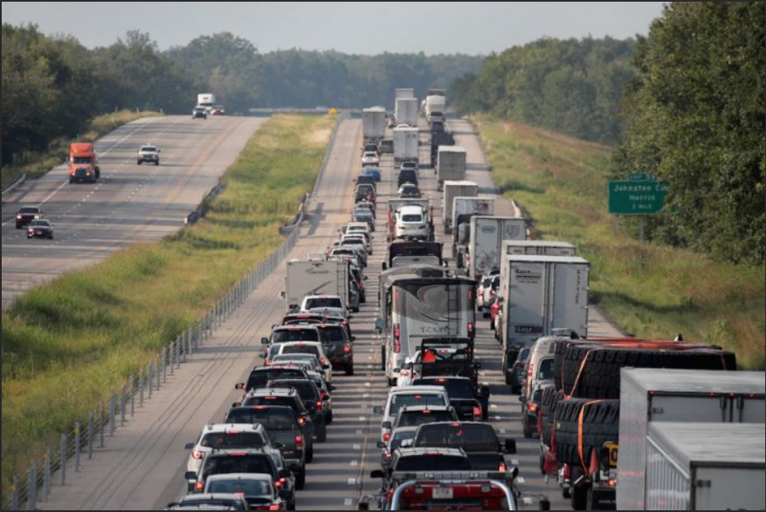
What do Locals need to plan for?
State and Delaware County are putting out the message:
  “Arrive Early, Stay Late, Stay Put”
Population surge
Traffic management
Local infrastructure stresses including fuel, grocery, water, and sanitation.
Notes:
Delaware County stakeholders are most concerned with traffic and communication per the 2022 survey

Slide 7

Delaware County Eclipse Website
https://co.delaware.oh.us/2024solareclipse/
County Commissions Office-Eric Weitz worked to create us a solar eclipse website that focuses on just Delaware County
Notes:
On this website is also a place for the public or you if you are interested to sign up to receive solar eclipse bulletins for continued information

Slide 8
What can You do to have a low stress eclipse day?
  Plan ahead, so you do not have to be in traffic
    Are there any areas where heavy traffic and an increased number of people will affect you?
  Are there any staffing concerns or shift change concerns?
Solar Eclipse Time Table
City | Lat | Long | Partial Eclipe Beginning | Totality Begins | Duration
Ashley | 40.40895 | 82.95546 | 13:56:13 | 15:11:43 | 2m 49.7s
Delaware | 40.29867 | 83.06797 | 13:55:54 | 15:11:36 | 2m 35.5s
Galena | 40.21506 | 82.8799 | 13:56:06 | 15:12:24 | 1m 24.1s
Ostrander | 40.26617 | 83.21269 | 13:55:39 | 15:11:17 | 2m 45.7s
Powell | 40.15784 | 83.07519 | 13:55:44 | 15:11:54 | 1m 45.3s
Shawnee Hills | 40.15784 | 83.13408 | 13:55:38 | 15:11:42 | 1m 58.5s
Sunbury | 40.2426 | 82.8591 | 13:56:10 | 15:12:22 | 1m 34.6s
Notes:
Any planning ahead you do for your own building, staff, and/or patrons can help with this effort.
Shift changes
Traffic issues for clients & staff
Any solar powered lights or other items which come on in darkness that may interrupt operations or block viewing if you are holding an event
Are there items which are popular at your business which you want to order or more or order restock sooner of
Communications with cell phones and wireless internet may be difficult
If you make a plan, please let DCOHSEM know so we can include your plan in overall planning efforts.

Slide 9
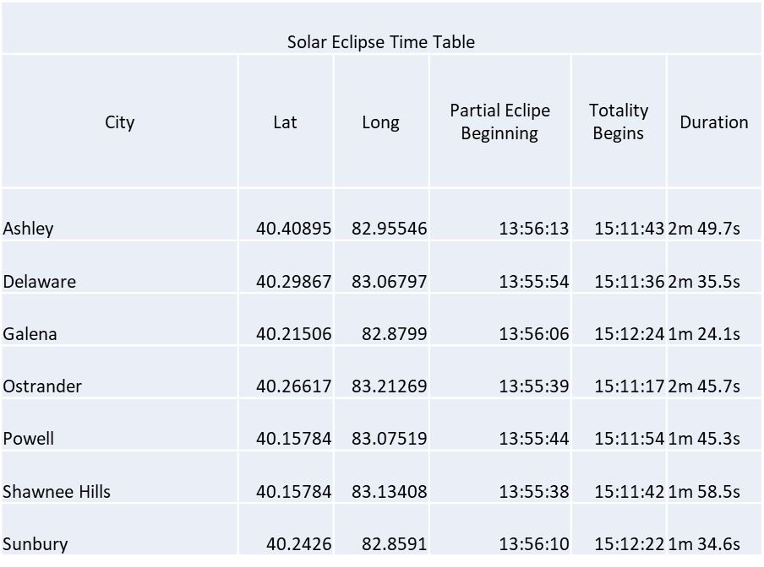
What can You do?
  Do you have the amenities you need for the event?
    Grocery, Maintenance, PPE, Gas etc.
Notes:
Any planning ahead you do for your own building, staff, and/or patrons can help with this effort.
If you make a plan, please let DCOHSEM know so we can include your plan in overall planning efforts.

Slide 10
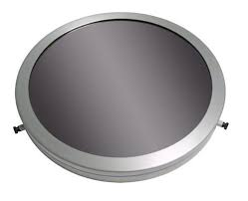
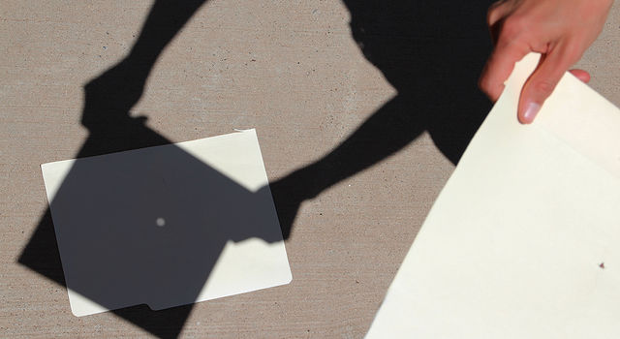
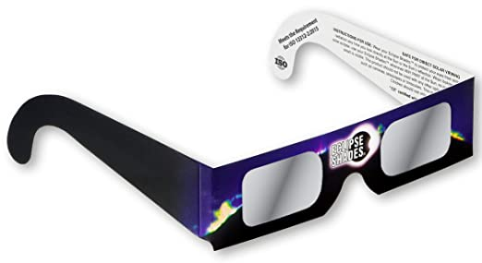
Eclipse Viewing Safety
Do not use to view | Okay to use to view
Sunglasses | Eclipse glasses with CE label
Multiple sunglasses | Special telescope filters for front end of scope
Mylar balloons | Pinhole projection/pinhole camera
Mylar food wrappers (pop tart bags) | Telescope projection
Smoked glasses | Welder’s glasses number 14 glass
X-ray film
Film negatives
CDs, DVDs, or CD-ROMs
Stacked welder’s glasses
Liquid filters(coffee, tea, used motor oil)
Eyepiece solar filters
Eclipse glasses and telescope together
Notes:
Don Stevens at Perkins Observatory is putting together information to be shared from a local source.
Also information is available on eclipse.ohio.gov
DCOHSEM also has other resources for education if needed.
Cell phones: Can damage the camera to take pictures, also not safe to view eclipse through cell phone camera
Viewing the eclipse without safety protection can cause same damage to eyes as staring at the sun.
Exposure of the retina to intense visible light causes damage to its light-sensitive rod and cone cells. The light triggers a series of complex chemical reactions within the cells which damages their ability to respond to a visual stimulus, and in extreme cases, can destroy them. The result is a loss of visual function which may be either temporary or permanent, depending on the severity of the damage. When a person looks repeatedly or for a long time at the Sun without proper protection for the eyes, this photochemical retinal damage may be accompanied by a thermal injury - the high level of visible and near-infrared radiation causes heating that literally cooks the exposed tissue. This thermal injury or photocoagulation destroys the rods and cones, creating a small blind area. The danger to vision is significant because photic retinal injuries occur without any feeling of pain (there are no pain receptors in the retina), and the visual effects do not occur for at least several hours after the damage is done [Pitts, 1993].
https://eclipse.gsfc.nasa.gov/SEhelp/safety2.html

Slide 11
What to Expect in your County
Delaware County has already been planning for the eclipse and has a completed operational plan for the day of the event.
This includes the EOC for Delaware County being open that day.
Included in the process are: emergency responders, critical infrastructure, communications, schools, parks, businesses, local officials, and others in the planning process.
We need your input and buy-in to get Delaware County prepared for this event so please reach out to your stakeholder and make sure they are aware.
Notes:
Current efforts (Dec 2023):
Event venue list
Stakeholder presentations
Regular meetings this year and situational meetings in 2024
Keeping track of hotel and campground reservation open dates for this day/weekend before
Delaware County EOC will be open the day of the eclipse to help with day of issues
We are preparing for the worst and hoping for the best
If you make plans for this event please let us know.

Slide 12
Thank you!
Do you have any questions?
Jecy Weber, jecy@delcoema.org
https://co.delaware.oh.us/2024solareclipse/
Notes:
Ohio Eclipse Website:
eclipse.ohio.gov
Delaware County Website:
https://co.delaware.oh.us/2024solareclipse/

