Slide 1
Solar Eclipse Situational Update Meeting
Feb 20, 2024 at 9:00 am

Slide 2
Delaware County Eclipse Website
https://co.delaware.oh.us/2024solareclipse/
County Commissions Office-Eric Weitz worked to create us a solar eclipse website that focuses on just Delaware County
Notes:
On this website is also a place for the public or you if you are interested to sign up to receive solar eclipse bulletins for continued information

Slide 3
Solar Eclipse Time Table
City | Lat | Long | Partial Eclipse Beginning | Totality Begins | Duration
Ashley | 40.40895 | 82.95546 | 13:56:13 | 15:11:43 | 2m 49.7s
Delaware | 40.29867 | 83.06797 | 13:55:54 | 15:11:36 | 2m 35.5s
Galena | 40.21506 | 82.8799 | 13:56:06 | 15:12:24 | 1m 24.1s
Ostrander | 40.26617 | 83.21269 | 13:55:39 | 15:11:17 | 2m 45.7s
Powell | 40.15784 | 83.07519 | 13:55:44 | 15:11:54 | 1m 45.3s
Shawnee Hills | 40.15784 | 83.13408 | 13:55:38 | 15:11:42 | 1m 58.5s
Sunbury | 40.2426 | 82.8591 | 13:56:10 | 15:12:22 | 1m 34.6s
Notes:
One of my most common questions

Slide 4
I heard………………
Information that has come to us that you should be aware of

Slide 5
I have heard………
From the radio:
It was suggested that schools were closing to minimize liability for children looking directly at the sun. While this may have been in jest, we want you to know.
DCOHSEM:
We have been doing public outreach to different community groups. For example Sourcepoint, incoming township trustees, business groups, etc.

Slide 6
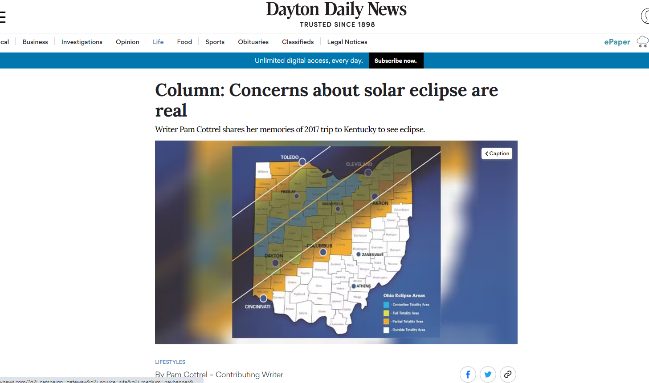
I heard…..
Pam Cottrel, of the Dayton Daily News gives a first-hand account of what it was like in Kentucky for the 2017 eclipse. She confirms the traffic and depleted resources we have been planning for.
Notes:
https://www.daytondailynews.com/lifestyles/column-cncerns-about-solar-eclipse-are-real/4OVQNCMOPRCIJIHCBPNDWMBIDE/

Slide 7
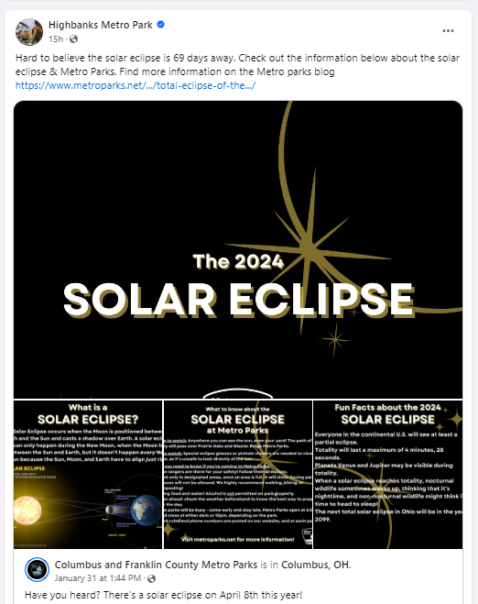
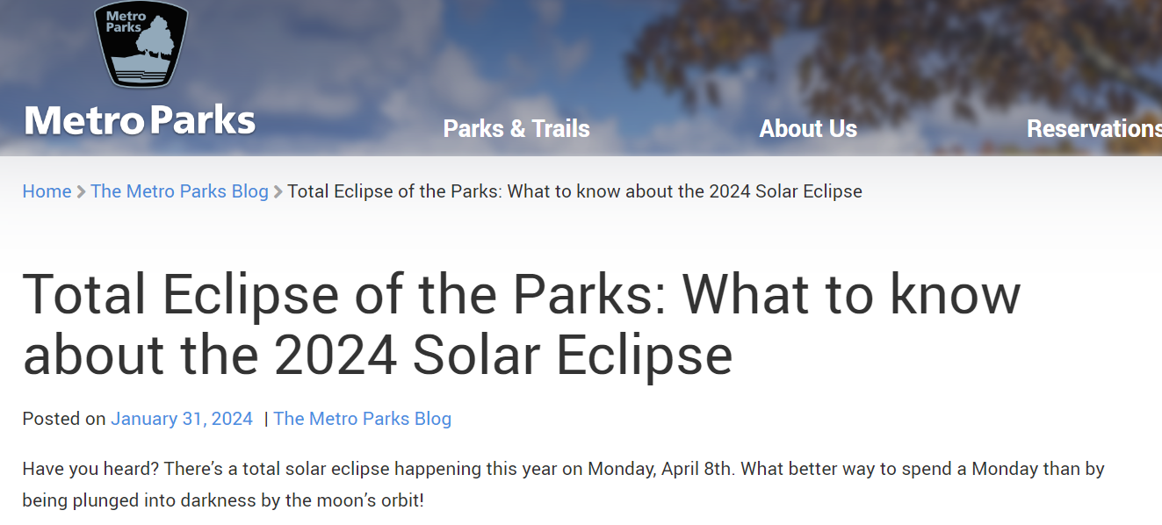
I heard…..
Our partners at Columbus Metro Parks have a solar eclipse page linked to their main website to help inform visitors about what to expect from the parks for the event
Also, the Social Media that goes with it
Notes:
https://www.metroparks.net/blog/total-eclipse-of-the-parks-what-to-know-about-the-2024-solar-eclipse/?fbclid=IwAR3eGNnP0ob0f7_-x1PhNLbEuToIuNrj7Ax5y_vSd61HdOPEzappENtsR6Y

Slide 8
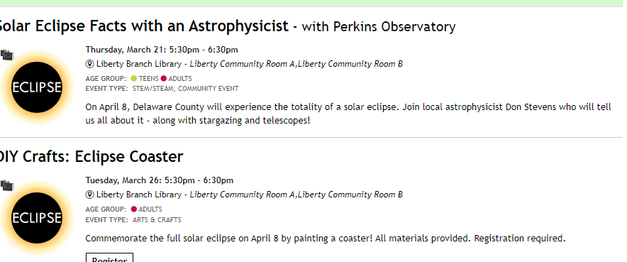
I heard….
Delaware County Libraries
Our partner is hosting/sponsoring a variety of programs on the eclipse
March 12th: Eclipse Education at Alum Creek State Park
Mar 21st: Solar Eclipse Facts with Astrophysicist from Perkins Observatory
Mar 26th: DIY Crafts: Eclipse Coaster
Mar 27th: Solar Eclipse Explorers
Mar 28th: Solar Eclipse Explorers
Apr 1st: Total Eclipse of the Heart
Dance Party
Notes:
https://www.visitdelohio.com/events/#events
https://delawarelibrary.libnet.info/events?a=Adults

Slide 9
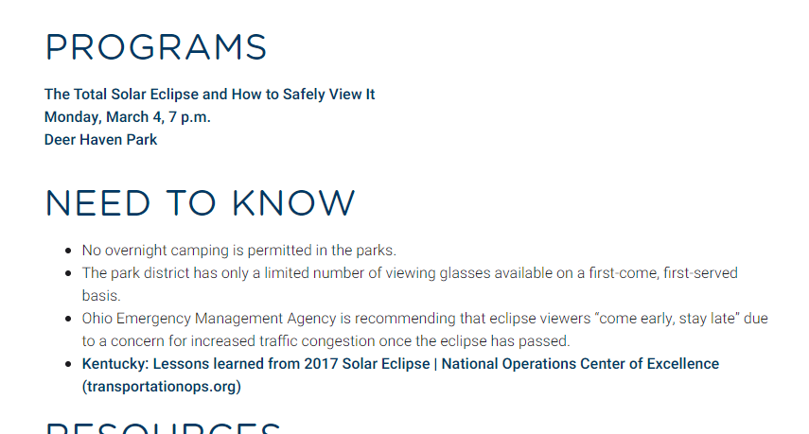
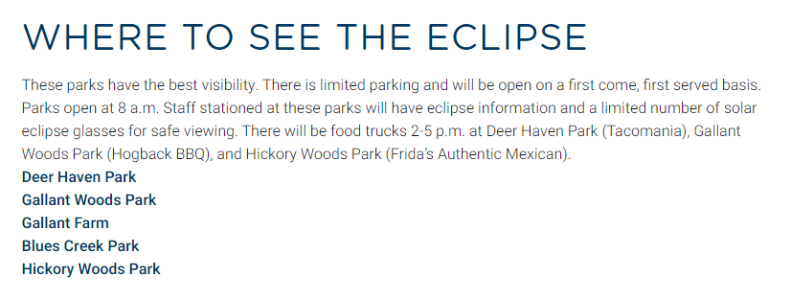
I heard………
Our partners Preservation Parks are hosting programming about how to safely view the eclipse as well as having food trucks on the day of the event at select locations.
Notes:
https://preservationparks.com/programs/solar-eclipse/

Slide 10
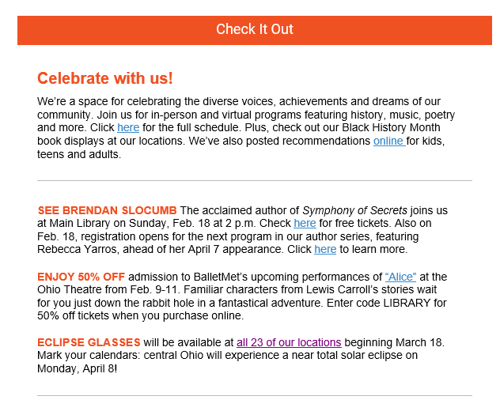
I have heard……
Columbus Metropolitan Library
ECLIPSE GLASSES will be available at all 23 of our locations beginning March 18. Mark your calendars: central Ohio will experience a near-total solar eclipse on Monday, April 8!
Notes:
https://www.columbuslibrary.org/library-locations/

Slide 11
I heard….
ODOT District 6 Projects
U.S. 36/SR 37 “POINT” EXPANSION |  | March 2023 to Sept 2025 | Widen U.S. 36/SR 37 under the railroad bridge on the east side of Delaware. Reconstruct the Norfolk-Southern railroad bridge over the roadway. Improve U.S. 36/SR 37 intersection at SR 521. Temporary lane closures with turn restrictions | as of Nov 2023
U.S. 36/SR 37 AND GALENA ROAD INTERSECTION IMPROVEMENTS |  | June 2023 to Oct 2024 | Install turn lanes on U.S. 36/SR 37 and Galena Rd., upgrade traffic signal, and add lighting. Temporary lane closures | as of Nov 2023
U.S. 36 IMPROVEMENTS AT I-71 |  | June 2023 to Oct 2024 | Replace U.S. 36 bridge over I-71, resurface U.S. 36 from east of Fourwinds Dr. to east of Wilson Rd. Temporary lane closures and turn restrictions | as of Nov 2023
U.S. 36/SR 37 Bridge Replacement |  | Spring 2023 to Fall 2024 | This project will replace the bridge deck and beams on U.S. 36/SR 37 over I-71 and resurface U.S. 36/SR 37 between Fourwinds Dr. and Wilson Rd. | as of Feb 2024
State Route 605 and Fancher Road Intersection Improvements |  | Winter 2023 to Fall 2024 | Improve the intersection of State Route 605 and Fancher Road in Delaware County by constructing a roundabout to increase safety and reduce congestion. | as of Feb 2024
SR 25/AW Trail Culvert Replacement |  | Winter 2023 to Fall 2024 | Replace culvert at Delaware Creek by boring a new pipe 50 feet below surface level. | as of Feb 2024
Delaware County Projects 2024-2025
Home Road Recreational Trail |  | September 2023 to May 2024 | 10-foot wide path along the north side of Home Road extending from Beautiful Savior Lutheran Church to Olentangy Liberty HS.
Berlin Station and Braumiller Intersection |  | June 2023 to July 2024 | Replacement of a large concrete culvert south of the intersection including road profile adjustment approaching the intersection completed in 2023. Remaining work to be done in 2024 includes minor pavement and shoulder widening on Berlin Station east to Glenn Parkway. Traffic maintained on Berlin Station
US36 / SR 37 and Galena Road |  | September 2023 to October 2024 | New left and right turn lanes on each intersection approach, along with a new traffic signal. Traffic will be maintained on US 36/SR 37. Short-term lane restrictions on US 36/SR 37 and closures on Galena Road. Joint project with ODOT
2024 Small Bridge Replacement Projects |  | March to November 2024 | Replacement of small bridges at the following locations. 2± month closures for each bridge. A.Dulin Road 1/4 mi. south of Steamtown Road B. Fontanelle Road 1/4 mi. east of Union Co. line C.North Galena Road 1/2 mi. north of Kilbourne Road D.Hartford Road 1/8 mi. east of Ross Road
Green Meadows Drive (Home to Lewis Center) |  | March to October 2024 | New 0.9 mile long, 3-lane road connecting the Lewis Center and North Road roundabout to the new Home Road Extension east of US 23. No traffic impacts during construction.
Notes:
Updated construction information from our Delaware County Engineer's Office,
I will attached update flyer and my spreadsheet to meeting notes.

Slide 12
Solar Eclipse Public Assistance funds with Director Alex McCarthy

Slide 13
Ohio EMA County Eclipse Video Conference
Feb 8, 2024, was our last call
Presentation was broken into different topics
Where do the numbers for population estimates come from?
Ohio Sentry eclipse event tracker
Congestion mapping
Eclipse Task Force update
Communications
Ohio EMA TTX Review
Questions?

Slide 14
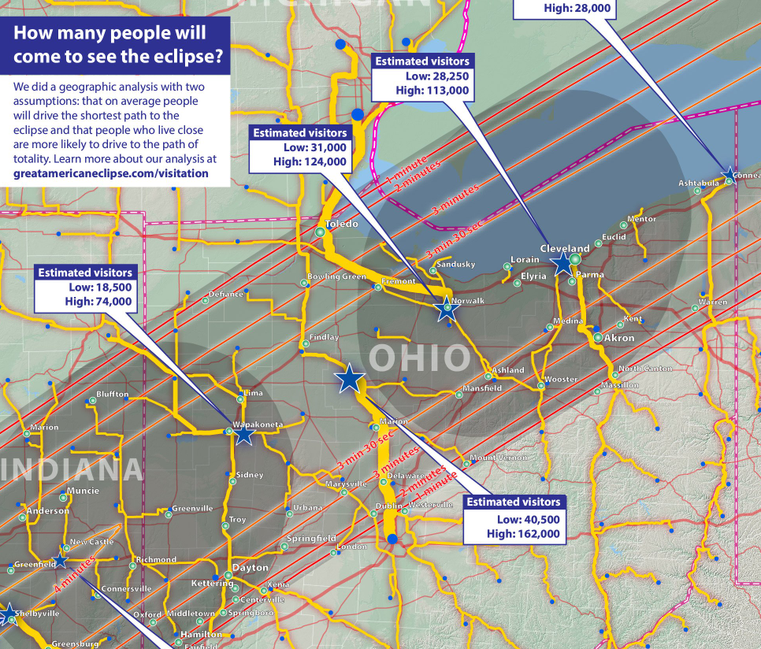
Where do the numbers for population estimates come from?
Population estimates for how many people are coming into Ohio in addition to those who are living here are based on the Great American Eclipse Website.
Ohio EMA verified the author of these estimations
The Great American Eclipse website is the same one we reviewed last meeting in depth.
Ohio population: 125,000-500,000
These are just coming in from out of state, estimate does not include in-state movement
Notes:
https://www.greatamericaneclipse.com/visitation

Slide 15
Where do the numbers for population estimates come from?
Ohio EMA is also continuing to work with hotel & lodging groups & Ohio Department of Development to get an idea on reservations, which also shows what numbers we can expect.

Slide 16
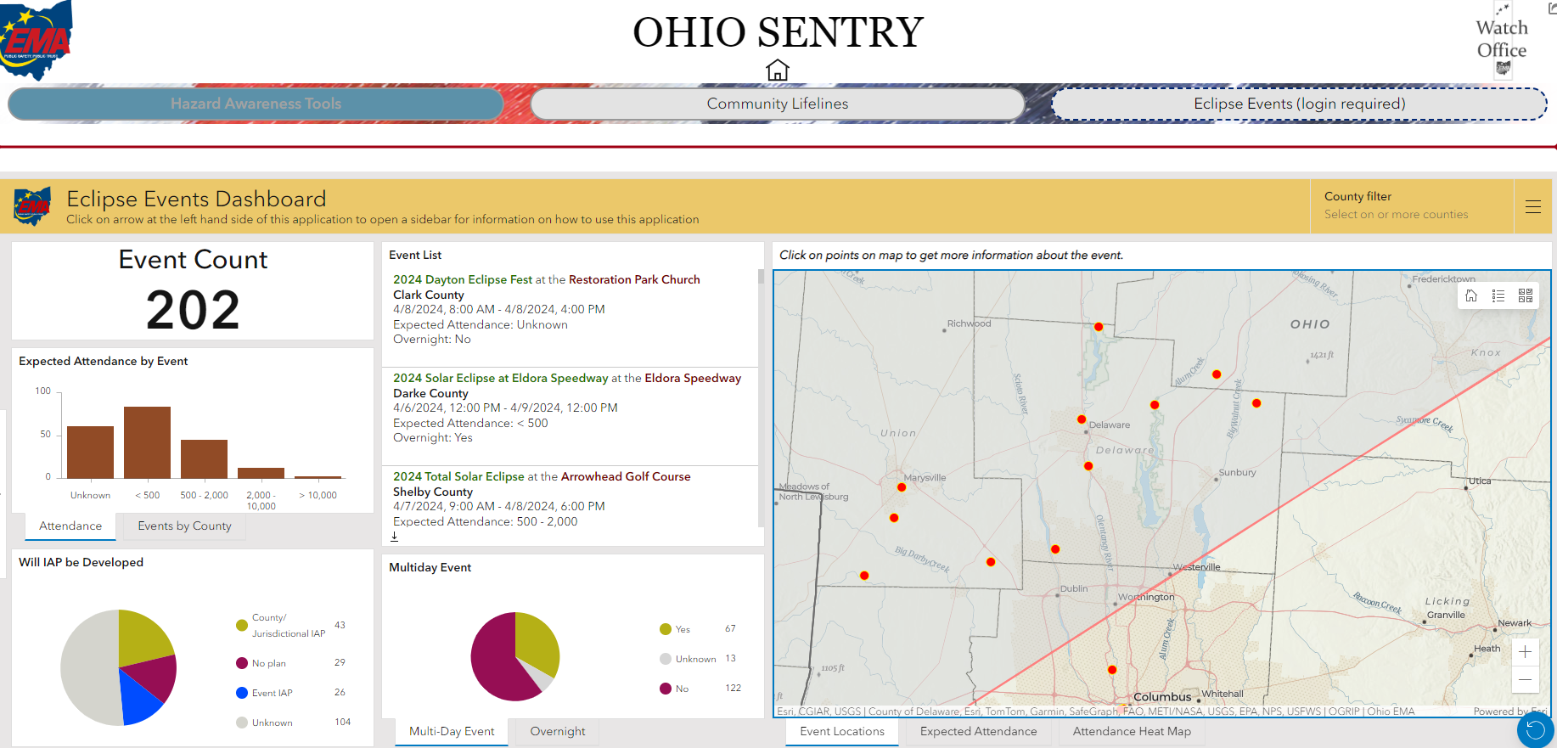
Ohio Sentry Eclipse Event Tracker
Notes:
2.8.2024 count

Slide 17
Congestion Mapping

Slide 18
Congestion Mapping
Notes:
Scenario used: Model of 575k visitors; with disproportionate attempt to get to the Findlay/Kenton areas - what would 50k people trying to get to that area look like for worst case scenario planning?
Model looks at total visitors-then allocated by county- then allocated to hotel bound & not hotel bound (w/in totality path)- then to TAZ
Best analyzed by comparing changes to congestion between a “regular” day and the eclipse scenario
Limitations:
Eclipse Viewing: range of estimates of visitors – Scenario Planning
• Model does not account for queuing or spill back of congestion
• Statewide Model with aggregate resolution
• It’s a planning tool

Slide 19
Eclipse Task Force update
Last meeting was 2.7.2024
OPS engagement (public/ private sector group): working on messaging for private partners and sharing concerns brought up by counties
ODOT: no active construction that day, will have as many lanes open as possible
Ohio Department of Education: referring schools to local EMAs for eclipse information.

Slide 20
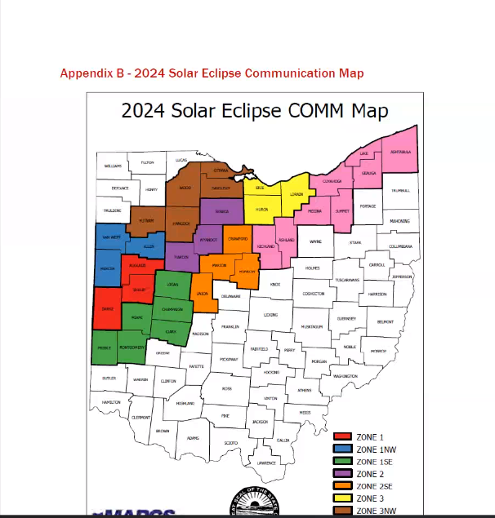
Communications
These zones are for MARCS radio on map
Ohio EMA expressed a need for responder entities to sign up for wireless priority service prior to the eclipse

Slide 21
Ohio EMA TTX Review & Questions?
TTX
Information sharing & gathering are key. Weekend & day of please share information through the watch office at Ohio EMA
Resource requests: these will use the established system to manage. Please include details on what and why.
Communication: The Departments of Administration & Justice both have access to language interpretation services. Also, the website below has Eclipse Viewing instructions in more than 100 languages!
https://eclipse2024.org/instructions/languages.html
Legal: Please seek information from your appropriate council on legal questions
More detailed AAR to come at a later date
Questions?
USPS- still unknown if they are having a regular schedule or not
Still unknown if agencies that cross between MARCS and not MARCS counties have any special zoning
Notes:
https://eclipse2024.org/instructions/languages.html

Slide 22
Delaware County Events
Events and gatherings happening in the county
Notes:
Events in the order that I am made aware of them

Slide 23
Delaware County Events
Eclipse Traditions with the Delaware County Historical Society
Standard Program $75
DCHS Member Price $60
Student pricing $50
students recommended for grades 4+
Ticket Includes 1 pair ISO viewing glasses, 1 food truck ticket for lunch, and 1 commemorative event T-shirt when purchased by February 1.
Doors open to standard ticket holders 10:00 am
*See below for add-on morning session*
Program welcome and land acknowledgment 10:45am
Dr John Low 11:00-12:00
Lunch Break (included in ticket)
Speaker to be announced 1:00-2:30
ECLIPSE EXPERIENCE
Speaker to be announced 4:30-5:30
Books and the marketplace will be available between experiences.
Notes:
https://www.visitdelohio.com/event_listing_type/eclipse-event/
https://www.eventbrite.com/e/eclipse-traditions-tickets-758223144837?aff=oddtdtcreator&fbclid=IwAR2J7hueZm2PD26XjWKb9bpyfDInIeRQi7twL8LcanzaNyIGVuDfe0kO5iM

Slide 24
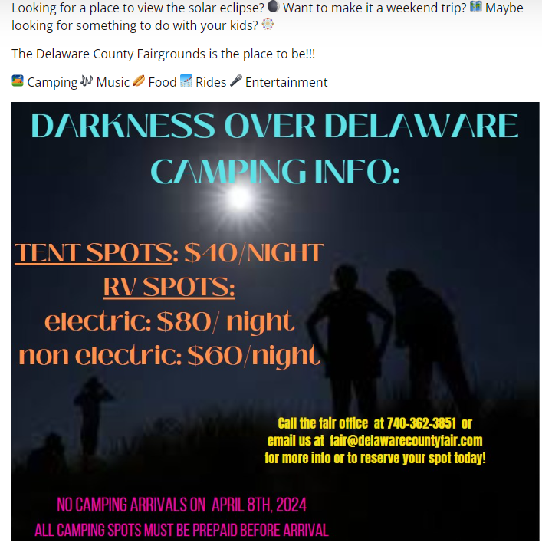
Delaware County Events
Darkness over Delaware at the Delaware County Fairgrounds
Looking for a place to view the solar eclipse? 🌒 Want to make it a weekend trip? 🗺️ Maybe looking for something to do with your kids? 🎡
The Delaware County Fairgrounds is the place to be!!!
⛺️ Camping 🎶 Music 🌭 Food 🎢 Rides 🎤 Entertainment
As of 2/1/2024: capacity for about 250 campers and 150 tents

Slide 25
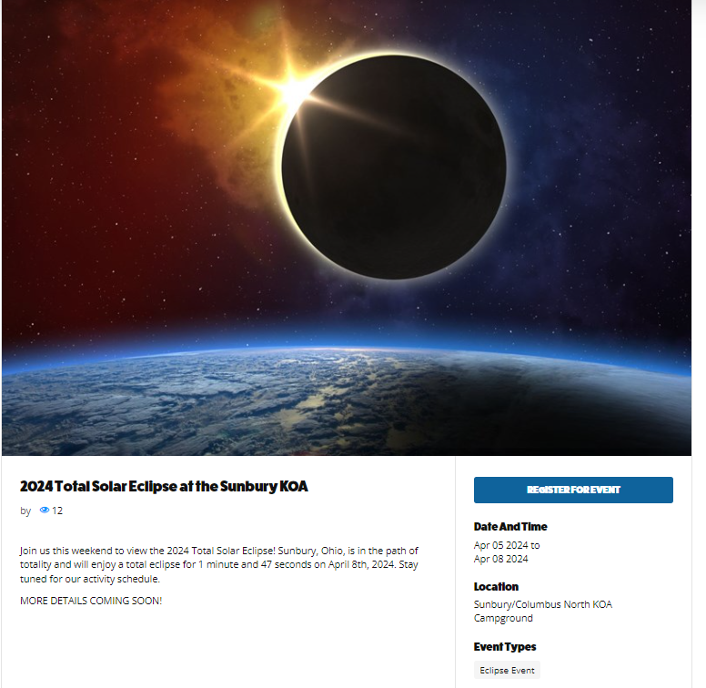
Delaware County Events
2024 Total Solar Eclipse at the Sunbury KOA
Join us this weekend to view the 2024 Total Solar Eclipse! Sunbury, Ohio, is in the path of totality and will enjoy a total eclipse for 1 minute and 47 seconds on April 8th, 2024. Stay tuned for our activity schedule.
MORE DETAILS COMING SOON!
Notes:
https://www.visitdelohio.com/event_listing_type/eclipse-event/

Slide 26
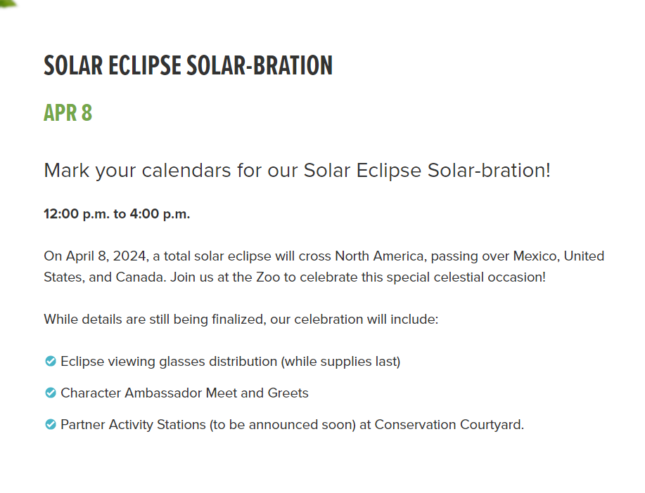
Delaware County Events
SOLAR ECLIPSE SOLAR-BRATION
On April 8, 2024, a total solar eclipse will cross North America, passing over Mexico, United States, and Canada. Join us at the Zoo to celebrate this special celestial occasion!
While details are still being finalized, our celebration will include:
Eclipse viewing glasses distribution (while supplies last)
Character Ambassador Meet and Greets
Partner Activity Stations (to be announced soon) at Conservation Courtyard.
Notes:
https://www.visitdelohio.com/event_listing_type/eclipse-event/
https://www.columbuszoo.org/events/solar-eclipse-solar-bration

Slide 27
Delaware County Events
Solar Eclipse Viewing Party at Henmick Farm & Brewery
Monday, April 8, 2024
We’ll be open to the public to experience the solar eclipse.
Experience the totality of a solar eclipse at Henmick! Craft beer, craft cocktails & local food trucks. Open to the public and all ages welcome.
Guests are required to bring their own viewing glasses.
Food Trucks:
Grunt Grub
The Smokehouse 614
PT Thai Food .
Notes:
https://www.visitdelohio.com/event_listing_type/eclipse-event/
Visit co.delaware.oh.us/2024solareclipse for more information regarding the eclipse

Slide 28
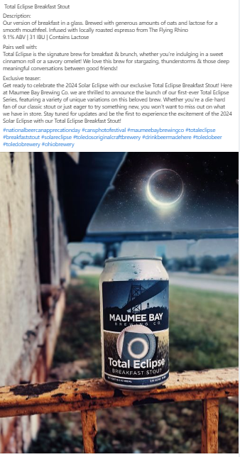
Delaware County Events
Shawnee Station Tap Room Kitchen
This is a new business in Shawnee Hills, which is preparing to open in time for the eclipse and their parent company has already started advertising Total Eclipse Breakfast Stout.
Notes:
Parent Company
https://www.facebook.com/mbaybrew
Shawnee Station
https://www.facebook.com/shawneestationtaproomkitchen

Slide 29
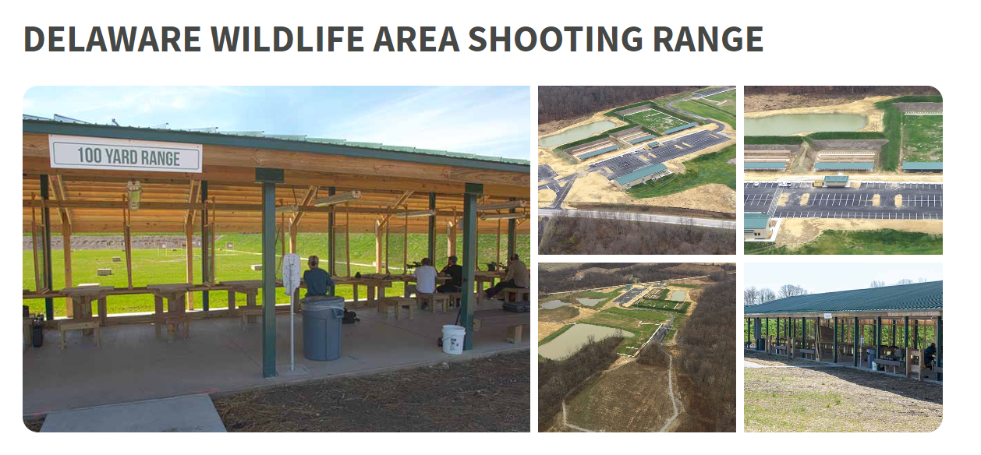
Delaware County Events
Delaware Wildlife Area Public Shooting
We have law enforcement and non-commissioned staff present and will be offering fishing and archery at our range.
Offer single-day parking use to view the eclipse. No overnight accommodations
The event is from 10 am to 5 pm
Expecting less than 500 people, 246 parking spaces
Notes:
https://ohiodnr.gov/go-and-do/see-the-sights/solar-eclipse-2024

Slide 30
Delaware County Events
Total Eclipse of the Park
At Freedom Park in Sunbury, OH 830 State Route 61 N
Handing out eclipse glasses
Event scheduled to start at noon
Some children’s activities

Slide 31
Delaware County Events
WELCOME TO THE WINERY AT PORTER CENTRAL
A MICRO WINERY & CIDERY
More details coming soon
Notes:
https://www.visitdelohio.com/event_listing_type/eclipse-event/
https://www.facebook.com/VineyardatPorterCentral/
https://woolandvine.com/?fbclid=IwAR1OcrQwPMJ8qTjKS959zdWGV-Kk8YwyYYr2_v42SLtlbK7Cyv2yB1Uc5dc

Slide 32
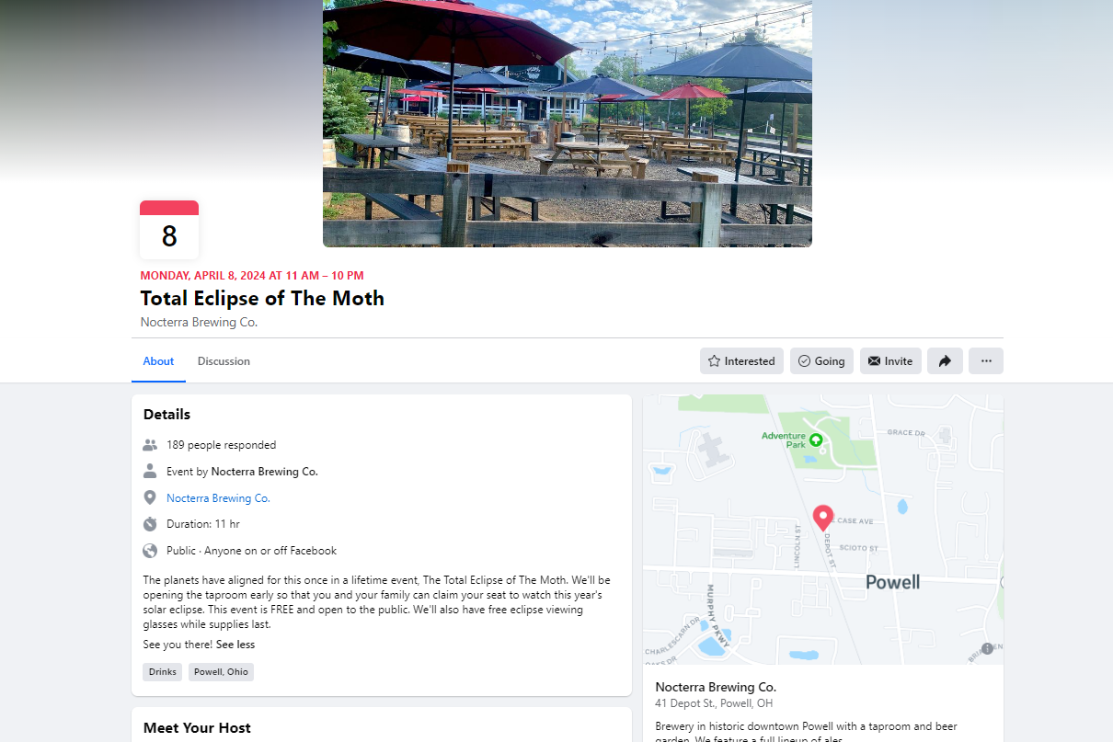
Delaware County Events
Total Eclipse of the Moth
Nocterra Brewing Co
11 am-?
~200 people have shown interest so far on SM
The planets have aligned for this once-in-a-lifetime event, The Total Eclipse of The Moth. We'll be opening the taproom early so that you and your family can claim your seat to watch this year's solar eclipse. This event is FREE and open to the public. We'll also have free eclipse viewing glasses while supplies last.
Notes:
https://www.facebook.com/events/351682627839819?active_tab=about

Slide 33
Nearby Events to be aware of…….
Dublin Libary Parking Garage | 75 N High St, Dublin, OH | Franklin |  | 500 |  | VIP event
Dublin Coffman Park | 5200 Emerald Pkwy, Dublin, OH | Franklin |  | 600 |  | students
Amberleigh Pavilion | 4715 Vista Ridge Dr, Dublin, OH | Franklin |  | 50 |  | uninvited expected so could be more
Public Library Association | 400 N. High Street, Columbus, Ohio, 43215 | Franklin | not eclipse | 5000+ | https://www.placonference.org/event/016e56a2-bc16-4851-a9ce-699d90a92e7c/summary | First time for confernce to be in Columbus
Moon Over Cardinal | 3547 County Road 225, Marengo, OH, 43334 | Morrow |  | Apr 5-8: 500-2000 | https://www.thecardinalcenter.com/blank | games, music, food, camping
Total Solar Eclipse Party | 222 E 8th St, Marysville, OH, 43040 | Union |  | less than 500 |  | Food trucks and entertainment will be provided.
Cirque Du Soleil | 555 Borror Dr, Columbus, OH 43210 | Franklin | not eclipse | April 4-7: 2,000 - 10,000 | https://www.cirquedusoleil.com/usa/columbus-ohio/crystal/buy-tickets?gad_source=1&gclid=CjwKCAiAlJKuBhAdEiwAnZb7leEGLlmPJJ7BaUZO8C1Zzjxhsg6EU3O4x-v8sG2lp_bsFkVjxCH8zBoCFxUQAvD_BwE
Eclipse Watch Party Presented By: Mitchell's Berries & Blooms | 9331 Mitchell Dewitt Rd, Plain City, OH, 43064, | Union |  |  | https://mitchellsberries.com/ | glasses giveaway (100), games & music, $5 per car
Total Eclipse on the Farm Presented By: Scheiderer Farms | 13436 State Route 38 Marysville, OH 43040 | Union |  |  | https://www.scheidererfarms.com/product/total-eclipse-of-the-farm/6290?cs=true
Black Out in the Barn: The Solar Eclipse | 8657 Axe Handle Road Milford Center Ohio 43045 | Union |  |  | https://www.mazeandberries.com/special-events/ | live music. Food, bar
Solar Eclipse Fly-In | 760 Clymer Rd Marysville, OH 43040 | Union |  | 11-3:30pm | https://webapp.aopa.org/destinations/event/432 | food, free admission

Slide 34
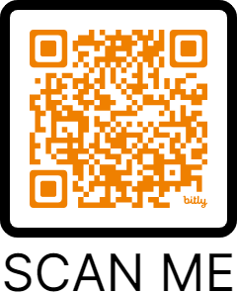
Questions, Comments, or Concerns?
Meeting Schedule
Feb 20th Situational Update @ 9am
Mar 22nd- Situational Update @ 9am
April 12th- After Action Review of Event @ 9am
All meetings are to take place here at Byxbe
Jecy Weber, jecy@delcoema.org, 740-833-2180
Notes:
https://docs.google.com/forms/d/e/1FAIpQLSf7OWBWT8528ydfzmR5XHXwNizr936hXxqtwGWleDFm79lqmQ/viewform?usp=pp_url

